Slide 1

HOLISTIC SEO
WORKBENCH
Next-Gen SEO Strategy & Content Generation Platform
Dominate Search Results with Semantic SEO

Slide 2

THE SEO STRUGGLE IS REAL
"What content should I write next?"
No clear content strategy or topic prioritization
"Why isn't my content ranking?"
Missing semantic relationships and topical authority
"How do I optimize for featured snippets?"
No systematic approach to SERP features
"AI content feels generic and robotic"
Single-pass generation lacks quality control

Slide 3
INTRODUCING
Holistic SEO Workbench
The only SEO platform that combines:
✓ Semantic Content Strategy (Entity-Attribute-Value Framework)
✓ 9-Pass AI Content Generation with 129+ Quality Audit Rules
✓ Featured Snippet Optimization Built-In
✓ Multi-Provider AI Support (OpenAI, Anthropic, Gemini, & more)

Slide 4
RESULTS YOU CAN EXPECT
9
129+
17+
5
Optimization Passes
Audit Rules
API Services
AI Providers
Per article
Quality checks
Integrated
Supported
Save 80% Time
Rank Higher
Scale Content
Automate content strategy & generation
Semantic SEO methodology built-in
Batch generation with quality control

Slide 5
129+ CONTENT WRITING & AUDIT RULES
Comprehensive quality assurance for every piece of content
31
5
5
Algorithmic Audit
Semantic/Pillar
Link Structure
Core SEO checks
Entity alignment
Internal linking
80+
6
5
Content Validators
Technical Rules
Visual/Schema
Quality rules
Format checks
Rich snippets
+ 8 Language-specific patterns for multilingual SEO

Slide 6
ALGORITHMIC AUDIT RULES (31)
Core SEO quality checks applied to every article
• intro-clarity
Validates introduction effectiveness
• active-voice
Promotes active voice usage
• heading-hierarchy
Ensures proper H1-H6 structure
• entity-mentions
Validates entity coverage
• keyword-prominence
Checks keyword placement
• semantic-density
Checks semantic richness
• content-depth
Validates topic coverage
• anchor-optimization
Internal link text quality
• readability-score
Flesch-Kincaid scoring
• meta-alignment
Title/meta consistency
• sentence-variety
Checks sentence length variation
• featured-snippet-ready
Structured for SERP features
• paragraph-structure
Validates paragraph density
• question-coverage
PAA optimization
• transition-words
Ensures content flow

Slide 7
CONTENT VALIDATOR RULES (80+)
Quality gates for publication-ready content
Introduction Quality
Structural Elements
• centerpiece-clarity
• list-optimization
• hook-effectiveness
• table-structure
• thesis-statement
• image-placement
Semantic SEO
SERP Features
• entity-coverage
• snippet-length
• attribute-depth
• answer-format
• predicate-variety
• definition-boxes
Link Quality
Technical
• anchor-diversity
• word-count
• contextual-relevance
• unique-value
• authority-signals
• duplicate-detection

Slide 8

ROI CALCULATOR
See the real impact on your content operations
MEDIUM BUSINESS
ENTERPRISE
20 articles/month
100+ articles/month
Traditional Cost
$6,000/mo
Traditional Cost
$30,000/mo
(writer + editor + SEO)
(team + tools + QA)
With Workbench
$1,500/mo
With Workbench
$5,000/mo
(AI costs + platform)
(AI + platform + review)
Time Saved
80 hours/mo
Time Saved
400 hrs/mo
(4 hrs → 45 min/article)
(entire content team)
Monthly Savings
$4,500
Monthly Savings
$25,000
75% cost reduction
83% cost reduction
* ROI increases with volume due to batch processing and template reuse

Slide 9
AI-FIRST vs FULLY AI-ASSISTED
Understanding our intelligent content creation approach
AI-FIRST APPROACH
FULLY AI-ASSISTED
• AI generates complete first drafts
• Human writes with AI suggestions
• 9-pass optimization system
• AI Strategist provides guidance
• Human reviews & refines output
• Real-time quality scoring
• Best for: Scale & efficiency
• Best for: Premium content
• Time: 30-45 min per article
• Time: 2-3 hrs per article
• Quality: 85-95% accuracy
• Quality: 95-100% accuracy
Both modes use the same 129+ audit rules for quality assurance

Slide 10
COMPLETE FEATURES - STRATEGY
Everything you need for semantic SEO success
Business Info Wizard
SEO Pillars Setup
Define company context, expertise areas, and target audience
Central Entity (CE), Source Context (SC), Central Search Intent (CSI)
EAV Discovery
Competitor Analysis
Entity-Attribute-Value semantic triples for topical authority
Analyze competitor content gaps and opportunities
Topical Map Generation
Knowledge Graph View
AI-powered topic clustering with 50-100+ topics
Visualize topic relationships and content network
Topic Prioritization
Content Calendar
Score topics by search volume, difficulty, and relevance
Plan and schedule content production

Slide 11
COMPLETE FEATURES - CONTENT CREATION
Multi-pass AI content generation system
Content Brief Generation
9-Pass Content Generation
SERP analysis, competitor specs, visual semantics, structured outline
Draft → Headers → Intro → Lists → Flow → Micro → Visual → Audit → Schema
Section-by-Section Writing
Featured Snippet Targeting
Resumable generation with retry logic and version history
Automatic snippet-length answers and structured data
Image Placeholder System
Internal Link Suggestions
AI-generated alt text with vocabulary-extending semantics
Contextual anchor text recommendations for topical clusters
Schema Generation (JSON-LD)
Batch Content Generation
Entity resolution via Wikidata, page type detection, auto-fix
Generate 50+ articles with consistent quality

Slide 12
COMPLETE FEATURES - ANALYSIS & TOOLS
Comprehensive SEO analysis suite
Unified Audit Engine
Semantic Analysis
129+ rules with real-time scoring and actionable feedback
Entity coverage, attribute depth, predicate variety scoring
Corpus Audit
Query Network Analysis
Site-wide content analysis for topical authority gaps
Map search queries to content and identify opportunities
Entity Authority Scoring
Competitor Gap Analysis
Measure topical authority by entity coverage
Find content gaps and outranking opportunities
Internal Link Audit
E-A-T Scanner
Neo4j-powered link structure analysis
Expertise, Authority, Trust signals analysis

Slide 13
CONTENT BRIEF - RESEARCH DEPTH
Every brief contains comprehensive SEO intelligence
SERP Analysis
Visual Semantics
• Featured snippet type
• Image placement map
• People Also Ask questions
• Alt text vocabulary
• Competitor analysis
• Visual context signals
• Search intent classification
• Schema markup hints
Structured Outline
Competitor Specs
• Section hierarchy
• Content length analysis
• Word count targets
• Topic coverage gaps
• Semantic anchors
• Keyword density
• Flow requirements
• Structure patterns

Slide 14
DRAFT MODE - 5 POWERFUL VIEWS
Complete control over your content creation process
EDIT
Rich markdown editor with requirements rail, section navigation, and inline AI suggestions
PREVIEW
Live HTML rendering with responsive preview and SEO meta preview
IMAGES
Image management panel for alt text editing, placement, and AI image generation
QUALITY
113+ rules in 18 categories with real-time scoring and improvement suggestions
DEBUG
Pass history, audit issues, AI conversation logs, and version comparison

Slide 15
AI STRATEGIST
Context-aware assistant powered by Holistic SEO methodology
✓ Understands your current context (topic, brief, draft)
EXAMPLE QUESTIONS:
✓ Provides strategic recommendations based on SEO pillars
"How can I improve this section for featured snippets?"
✓ Answers questions about Holistic SEO methodology
"What entities am I missing for topical authority?"
✓ Suggests improvements aligned with your business goals
"Suggest internal links for this paragraph"
✓ Multi-provider support (use your preferred AI)
"Is my introduction following Holistic SEO principles?"
✓ Quick actions for common tasks
"What PAA questions should I address?"
"How do I strengthen my E-A-T signals?"

Slide 16
17+ API SERVICES INTEGRATED
Enterprise-grade integrations for comprehensive SEO
Jina.ai
Apify
Firecrawl
DataForSEO
Content extraction & readability
Technical web scraping
Fallback scraping service
SERP analysis & keyword data
Wikidata
Neo4j
Cloudinary
MarkupGo
Entity resolution & knowledge graph
Graph database for link analysis
Image hosting & optimization
Dynamic image generation
WordPress API
Gemini
OpenAI
Anthropic
Direct publishing integration
Google AI for content generation
GPT-4 for content generation
Claude for content generation
Perplexity
OpenRouter
Supabase
Stripe
Research & fact-checking
100+ model access
Backend & authentication
Billing & subscriptions
All API keys encrypted with AES-GCM • No markup on AI costs

Slide 17
WORDPRESS PUBLISHING
Seamless content publishing workflow
CONNECTION SETUP
PUBLISHING WORKFLOW
• REST API or Application Passwords
• Draft/Publish/Schedule options
• AES-GCM encrypted credentials
• Conflict detection & resolution
• Test connection validation
• Media upload handling
• Category/tag mapping
• Custom field support
KEY BENEFITS:
One-click publish from draft editor • Automatic featured image upload
SEO meta (Yoast/RankMath compatible) • Batch publishing for multiple articles
Version history with WordPress sync • Custom taxonomy support

Slide 18
MIGRATION WORKBENCH
Comprehensive site migration and content audit platform
▦
▤
◎
▣
MATRIX VIEW
KANBAN VIEW
GRAPH VIEW
TRIAGE VIEW
Spreadsheet-style page inventory with bulk editing
Drag-drop workflow for migration stages
Visual link structure and relationships
Priority-based decision making interface
MIGRATION FEATURES:
• Site Inventory Import:
Import from sitemap, crawl data, or CSV files
• Semantic Analysis:
Score existing content against Holistic SEO framework
• Redirect Mapping:
Generate htaccess or nginx redirect rules
• Content Decisions:
Keep, migrate, merge, redirect, or retire pages
• Gap Analysis:
Identify missing topics for new content creation
• Export Options:
CSV, redirect rules, migration checklist

Slide 19
HOW IT WORKS
1
→
2
→
3
→
4
→
5
Define Strategy
Generate Map
Create Briefs
Generate Content
Audit & Export
Set up SEO pillars & semantic triples (EAVs)
AI creates topical map with 50-100+ topics
Generate content briefs with SERP analysis
9-pass optimization for each article
Quality checks & WordPress-ready export
From strategy to published content in one platform

Slide 20
9-PASS CONTENT GENERATION
Each article goes through 9 specialized optimization passes
1
Draft
2
Headers
3
Intro
Section-by-section content
Heading hierarchy
Centerpiece annotation
4
Lists
5
Flow
6
Micro
Featured snippet ready
Transitions & bridges
Linguistic optimization
7
Visual
8
Audit
9
Schema
Image placeholders
129+ rule quality check
JSON-LD generation
Result: Publication-ready content with no AI artifacts

Slide 21
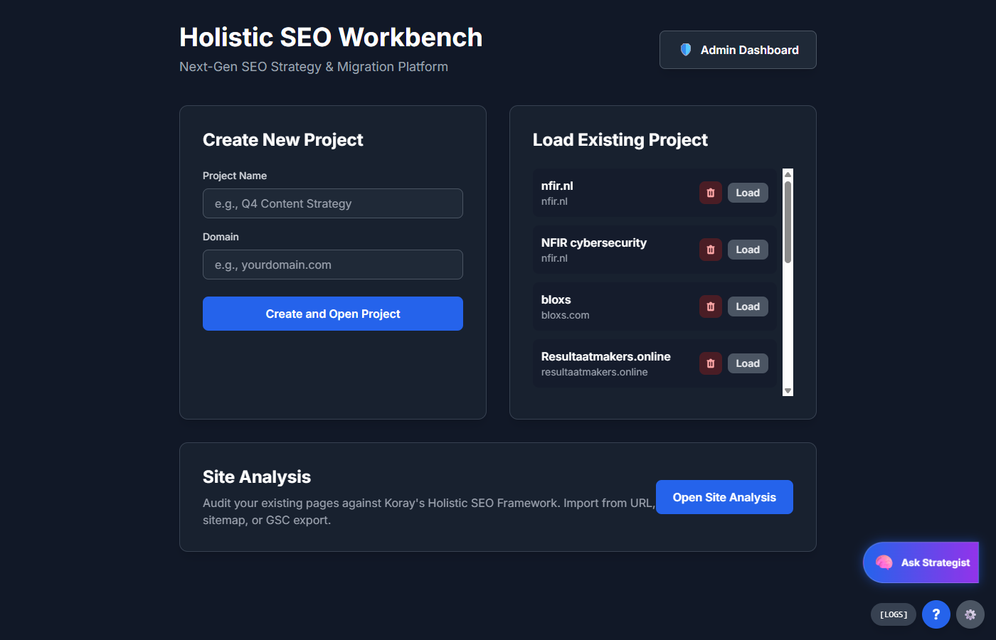
PROJECT MANAGEMENT
Manage multiple SEO projects from one dashboard

Slide 22
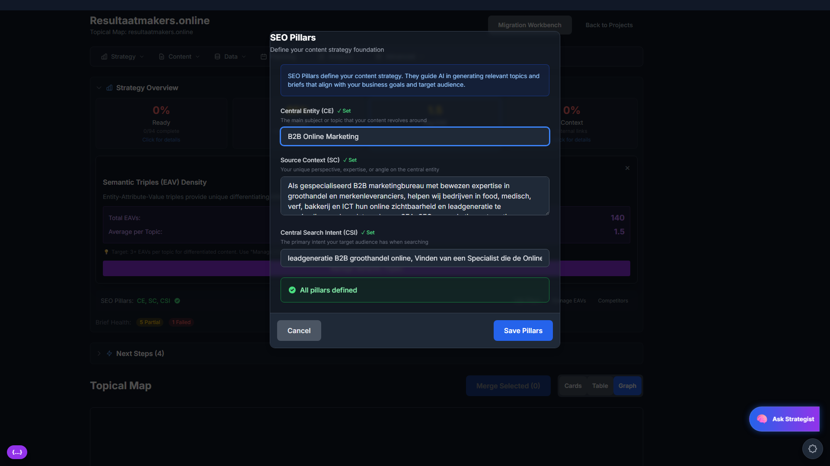
SEO PILLARS
Define your content strategy foundation
• Central Entity (CE) - Your main topic
• Source Context (SC) - Your expertise
• Central Search Intent (CSI) - User goals

Slide 23
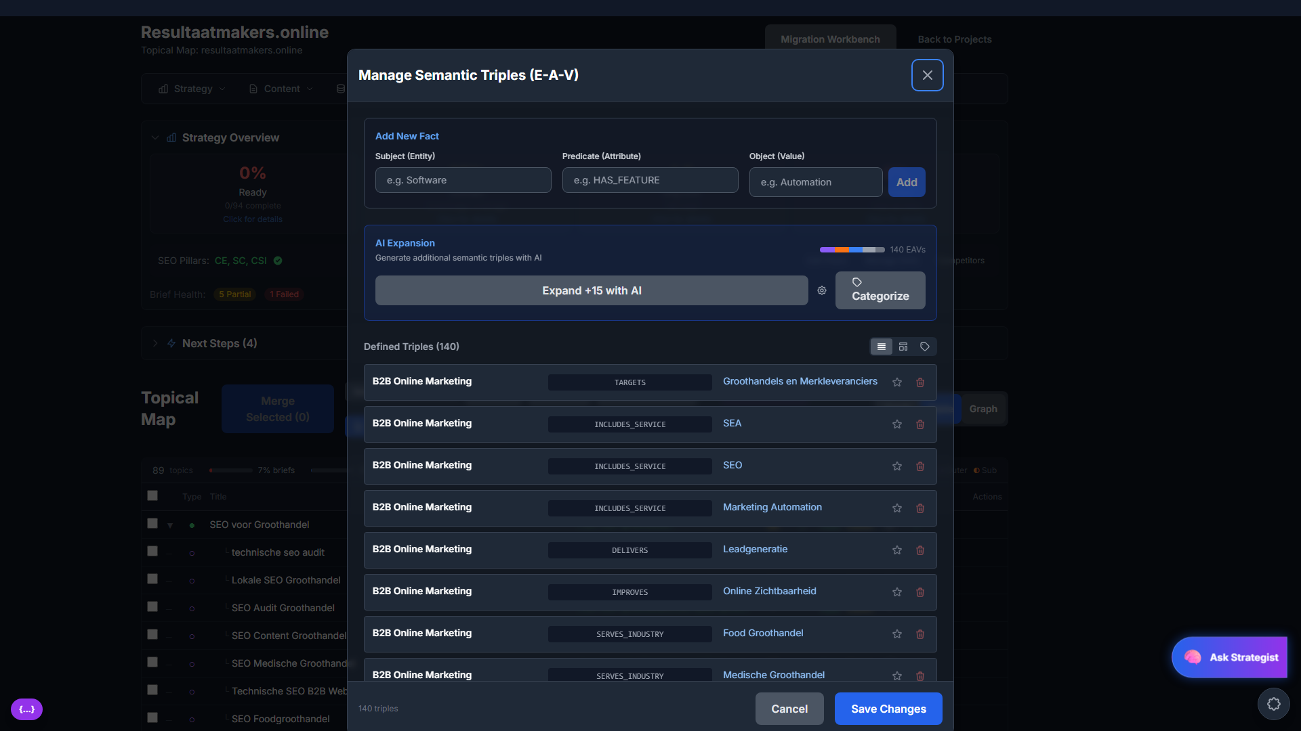
SEMANTIC TRIPLES (E-A-V)
The secret to topical authority - Entity-Attribute-Value framework

Slide 24
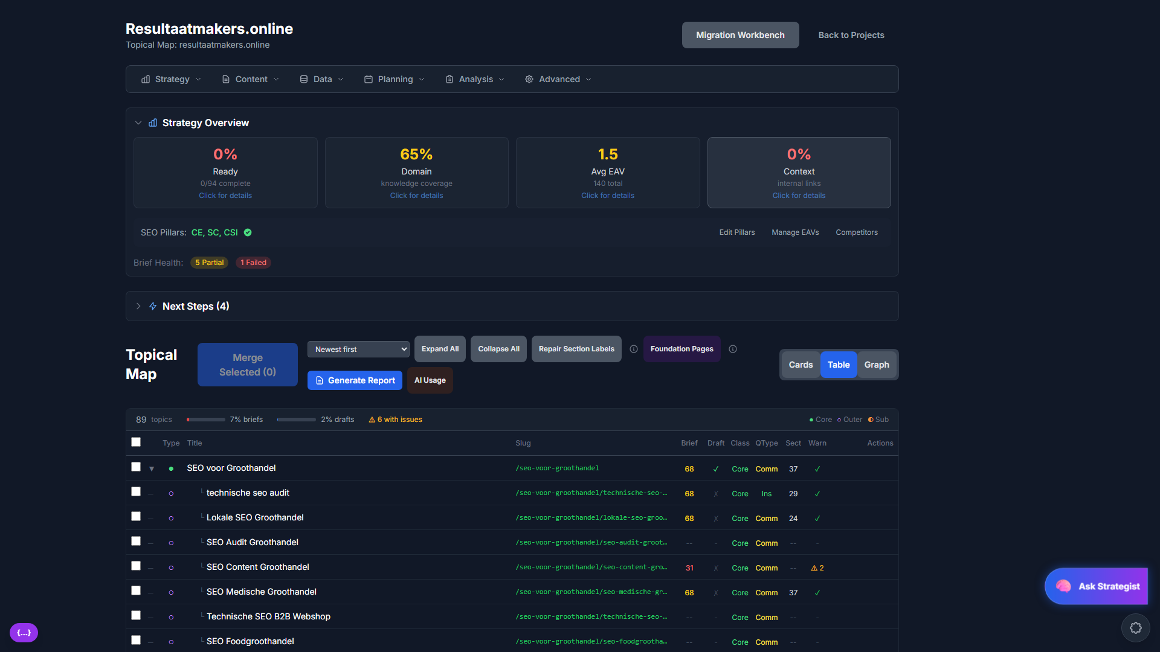
TOPICAL MAP DASHBOARD
Track 89+ topics with briefs, drafts, and metrics at a glance

Slide 25
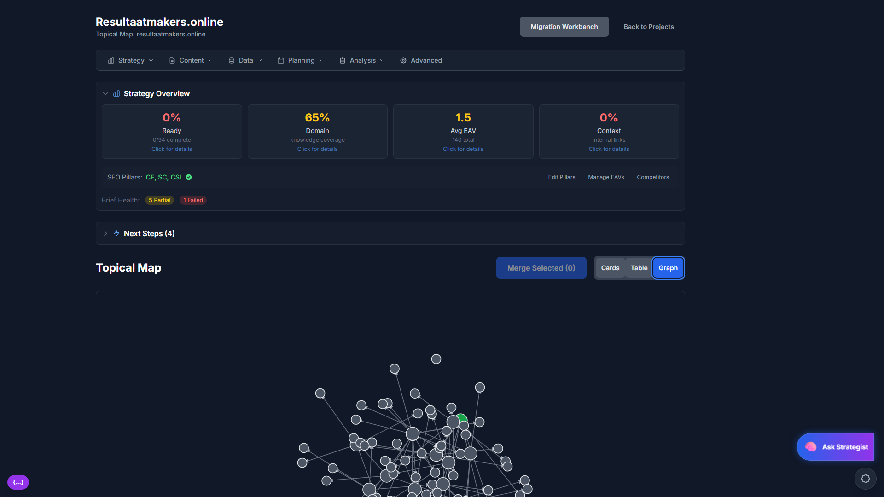
VISUAL TOPIC GRAPH
See your content network and topic relationships

Slide 26
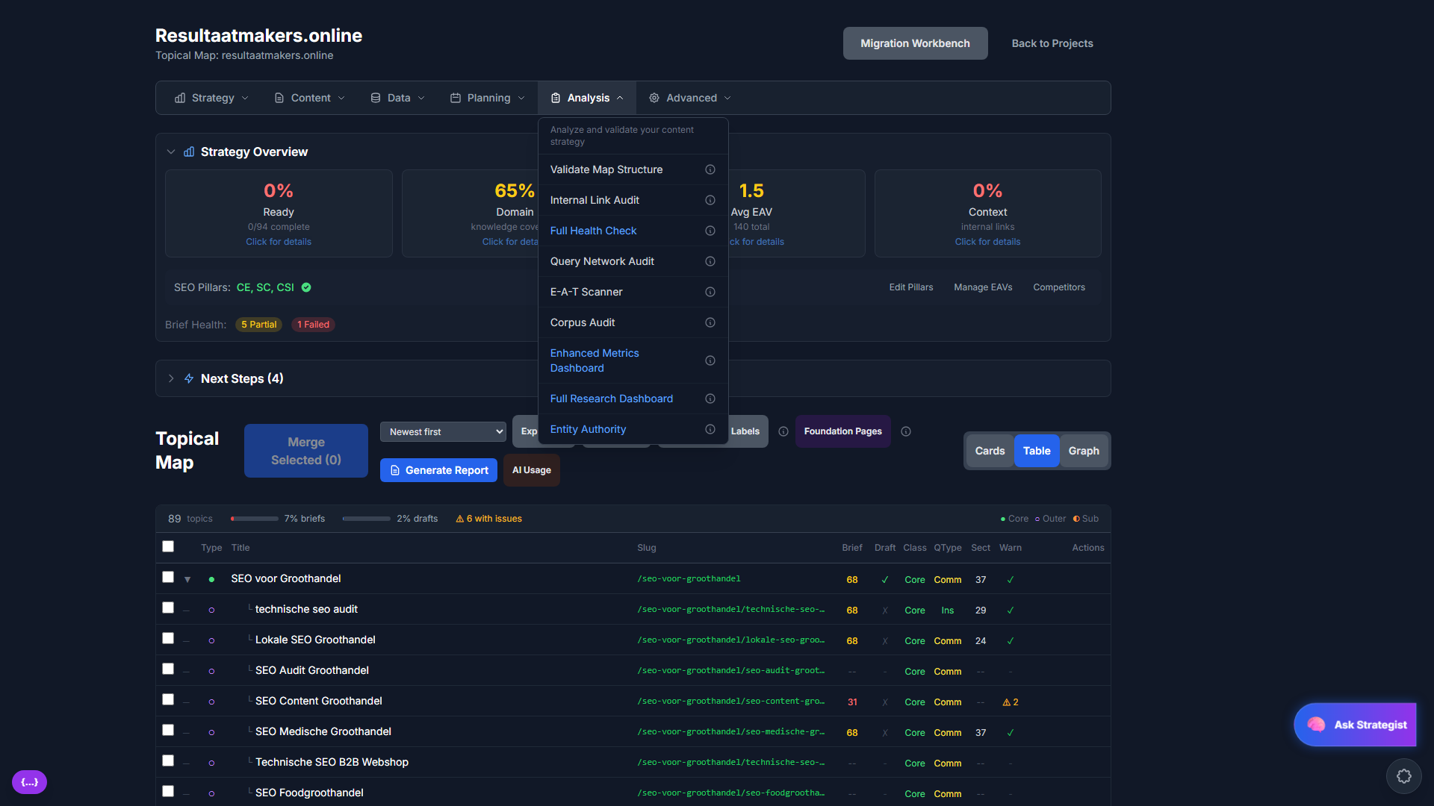
POWERFUL ANALYSIS TOOLS
• Internal Link Audit
• Full Health Check
• Query Network Audit
• E-A-T Scanner
• Corpus Audit
• Enhanced Metrics Dashboard
• Entity Authority Analysis

Slide 27
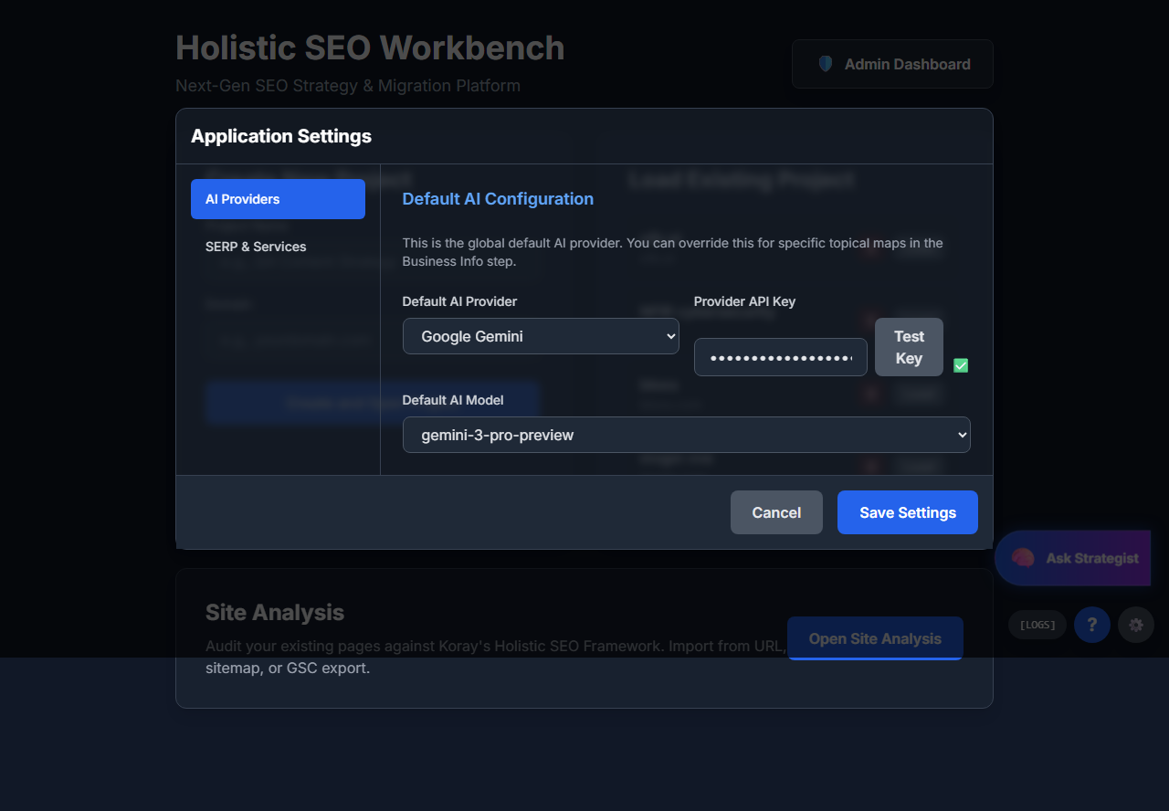
MULTI-PROVIDER AI SUPPORT
Choose your preferred AI provider:
✓ Google Gemini
✓ OpenAI GPT-4
✓ Anthropic Claude
✓ Perplexity
✓ OpenRouter (100+ models)
Bring your own API keys - no markup!

Slide 28
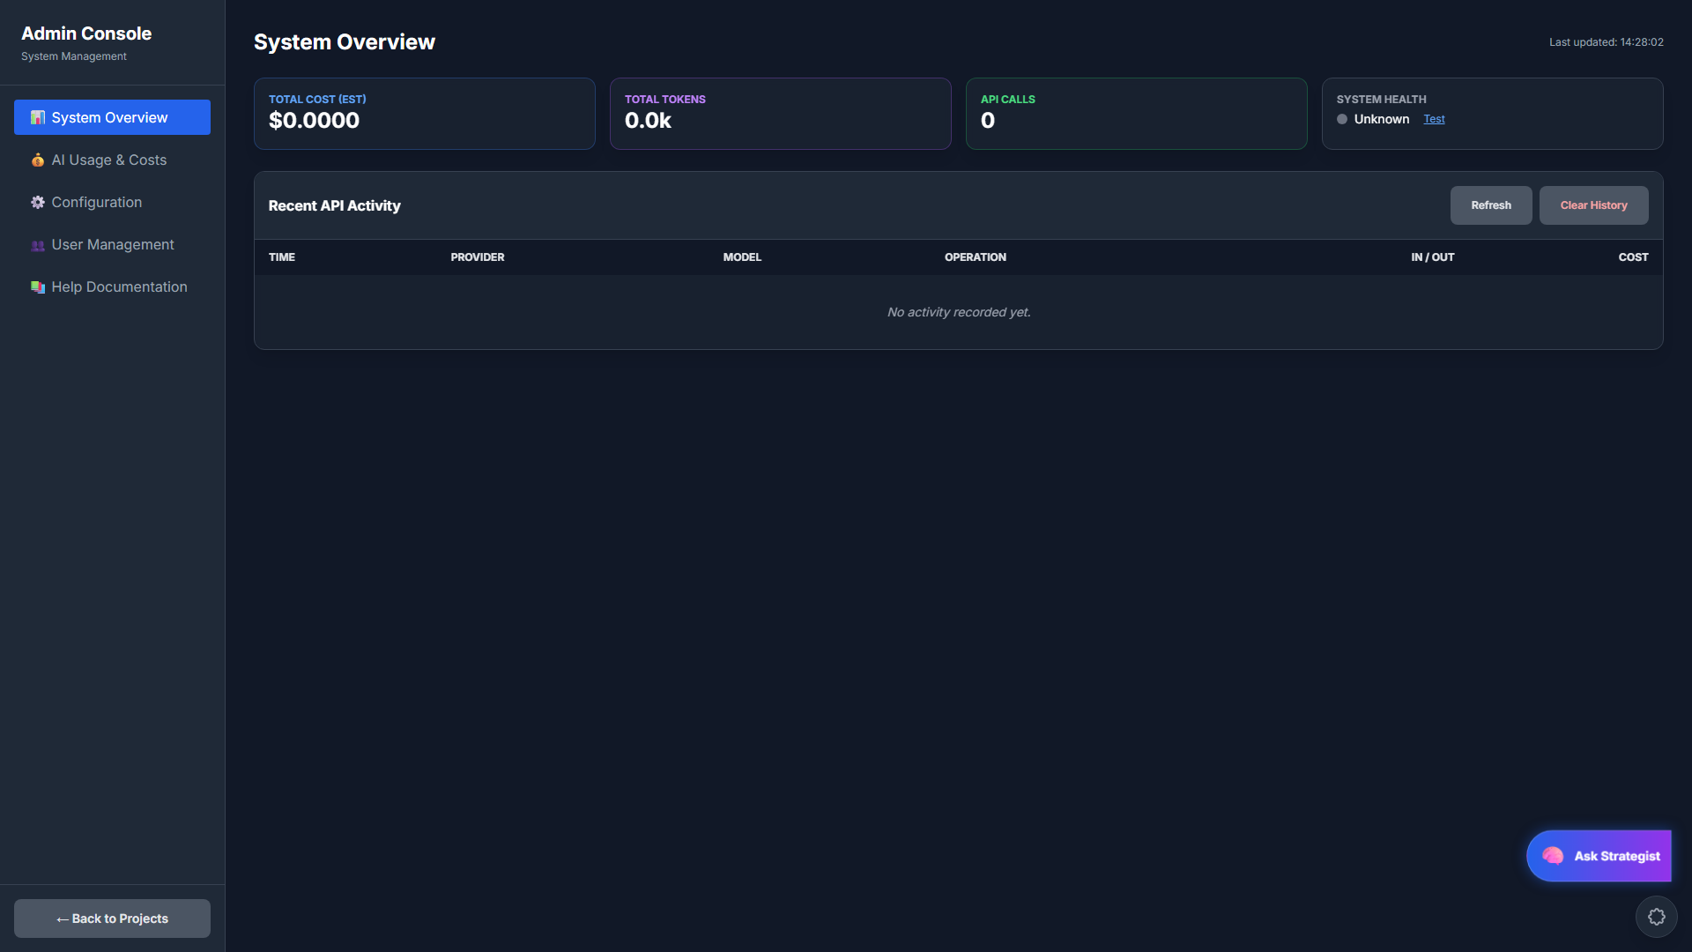
ADMIN CONSOLE
Track AI usage, costs, and system health in real-time

Slide 29
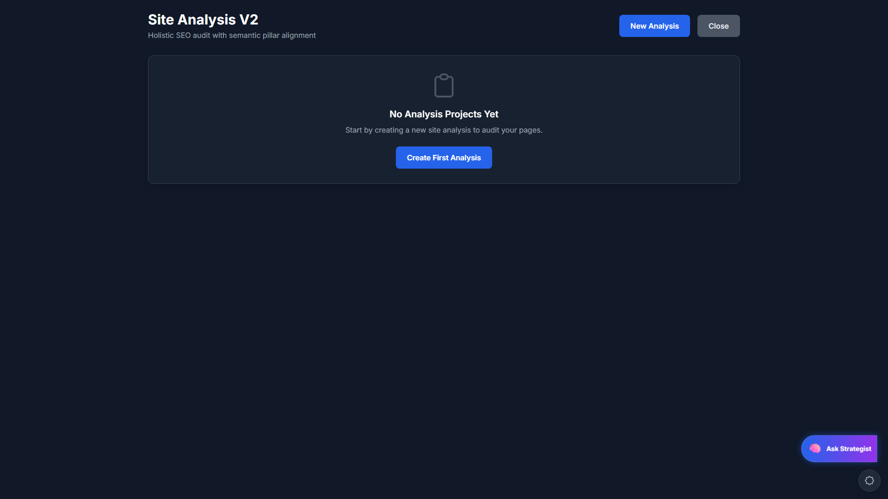
SITE ANALYSIS & MIGRATION
Audit existing pages against Holistic SEO framework

Slide 30
WHAT MAKES US DIFFERENT
Entity-Focused, Not Keyword-Focused
Build topical authority with semantic relationships
9-Pass Quality System + 129 Rules
Eliminates AI hallucinations and generic content
Featured Snippet Optimization
Built-in targeting with answer lengths and predicates
Holistic SEO Methodology
Based on proven framework by Koray Tugberk GUBUR

Slide 31
WHO IS THIS FOR?
SEO Agencies
In-House Teams
Content Writers
Scale content production across multiple clients with consistent quality
Build topical authority systematically with data-driven strategy
Get AI assistance that actually understands SEO best practices
Perfect for anyone who wants to dominate search results with quality content

Slide 32
ENTERPRISE-GRADE ARCHITECTURE
React 18 + TypeScript
Supabase Backend
Row Level Security
Modern, type-safe frontend
PostgreSQL + Edge Functions
Enterprise data isolation
Real-time Updates
Encrypted API Keys
Resumable Jobs
Live progress tracking
Secure credential storage
No lost work on interruptions

Slide 33
SIMPLE, TRANSPARENT PRICING
Starter
Professional
Enterprise
Free
$49/mo
Custom
✓ 1 Project
✓ Unlimited Projects
✓ Team Collaboration
✓ 10 Topics
✓ Unlimited Topics
✓ Custom Integrations
✓ Basic Briefs
✓ Full 9-Pass System
✓ White-Label Options
✓ Manual Generation
✓ Priority Support
✓ Dedicated Support
Bring your own AI API keys - pay only for what you use!

Slide 34
READY TO DOMINATE
SEARCH RESULTS?
Start building your topical authority today
GET STARTED FREE
holistic-seo-workbench.com

